Slide 1
Queueing Theory

Slide 2
Introduction
Many jobs share the system resources such as CPU, disks, etc, in a computer system. Example- Packets from different sources share the same buffer in a router.
Queuing theory helps in determining the time that the jobs spend in various queues in the system.
What is queuing theory?
Mathematical analysis of queues and waiting times in stochastic systems.
Used extensively to analyze production and service processes exhibiting random variability in market demand (arrival times) and service times.
Queues arise when the short term demand for service exceeds the capacity
Most often caused by random variation in service times and the times between customer arrivals.
If long term demand for service > capacity the queue will explode!

Slide 3
Delay Models
place
Computation
(Queuing)
propagation
transmission
C
B
A
time

Slide 4
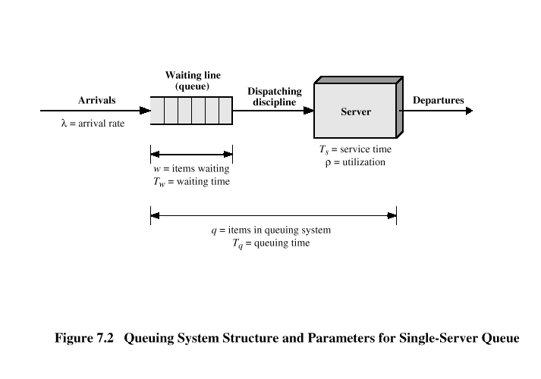
Queue Model

Slide 5
Queuing Theory
View network as collections of queues
FIFO data-structures
Queuing theory provides probabilistic analysis of these queues
Examples:
Average length
Probability queue is at a certain length
Probability a packet will be lost

Slide 6
Queuing Notation
For queuing analysis, need to specify:
Population size
Number of servers
System capacity
Arrival process
Service time distribution
Service discipline
Queue
Servers
Customer
Population

Slide 7
Notation
Population size
Potential customers who can enter
Most real systems finite but easier to analyze if infinite
Number of servers
Can be one or more
Assume identical, but if not then separate queuing system for each
System capacity
Number that can wait plus be served
The maximum number of customers who can stay in the system
Includes those waiting for service as well as those receiving service
Most systems have finite queue length, but easier to analyze if infinite

Slide 8
Arrival
Process
Queue
Customer
Population
Arrival process
Students arrive at t₁,t₂,…,t_{j}
Interarrival times are
τ_{j}=t_{j}-t_{j-1}
Usually assume independent, identically distributed (IID)
Most common are Poisson arrivals
IID and exponentially distributed (f(x)=λe^{-λx})

Slide 9
Service time distribution
Amount of time each customer at server
Again, usually IID
Most common are exponential
Service discipline
Order customers called for servicing
Most common is FCFS

Slide 10
Kendall notation
A/S/m/B/K/SD
A is Arrival time distribution
S is Service time distribution
m is number of servers
B is number of buffers
K is population size
SD is service discipline
Some typical times used:
M Exponential
M means “memoryless” in that current arrival independent of past
D Deterministic
G General
Valid for all

Slide 11
Variables for all queues
Queue
Previous
arrival
Servers
τ
Arrival
w
Begin
Service
s
End
Service
Time
τ = interarrival time
λ = mean arrival rate
= 1/E[τ]
Can sometimes depend upon jobs in system
s = service time per job
μ = mean service rate per server
= 1/E[s], total rate mμ
n_{q} = number of jobs waiting in queue
n_{s} = number of jobs receiving service
n = number of jobs in system
n = n_{q} + n_{s}
r = response time
w = waiting time
Note, all except μ and λ are random

Slide 12
Rules for All Queues (1 of 4)
Stability Condition
If the number of jobs becomes infinite, system unstable. For stability, mean arrival rate less than mean service rate
λ < mμ
Does not apply to finite queue or finite population systems
Finite population cannot have infinite queue
Finite queue drops if too many arrive so never has infinite queue

Slide 13
Rules for All Queues (2 of 4)
Number in System versus Number in Queue
Number of jobs is equal to waiting and servicing
n = n_{q} + n_{s}
Also means:
E[n] = E[n_{q}]+E[n_{s}]
So mean number of jobs is equal to mean number in queue plus mean number being serviced
Var[n] = Var[n_{q}]+Var[n_{s}]
Variance of jobs equal to variance of queue + svc
Also, service rate of servers independent of jobs in queue
Cov(n_{q},n_{s}) = 0

Slide 14
Rules for All Queues (3 of 4)
Number versus Time
If jobs are not lost due to buffer overflow the mean jobs is related to response time as:
mean jobs in system = arrival rate x mean response time
Similarly
mean jobs in queue = arrival rate x mean waiting time
Above equations known as “Little’s Law”
For finite buffers can use effective arrival rate (ignoring drops)

Slide 15
Rules for All Queues (4 of 4)
Time in System versus Time in Queue
Time spent in system is sum of queue and service time
r = w + s
In particular:
E[r] = E[w] + E[s]
If service rate independent of jobs in queue
Cov(w,s) = 0
Var[r] = Var[w] + Var[s]

Slide 16
Little’s Law
System
Arrivals
Departures
Little’s Law: Mean number tasks in system = arrival rate x mean response time
Observed before, Little was first to prove
Applies to any system in equilibrium, as long as nothing in black box is creating or destroying tasks
Monitor the system for a time interval T and keep a log of arrival and departure times of each individual job

Slide 17
Proving Little’s Law
Arrivals
Packet
#
3
3
# in
System
2
2
1
Departures
1
1 2 3 4 5 6 7 8
1 2 3 4 5 6 7 8
Time
Time
J = Shaded area = represent total time spent inside the system by all jobs. All three areas are equal
Time in
System
3
2
1
1 2 3
Packet #

Slide 18
Definitions
J: “Area” from previous slide
N: Number of jobs (packets)
T: Total time
λ: Average arrival rate
N/T
W: Average time job is in the system
= J/N
L: Average number of jobs in the system
= J/T

Slide 19
Proof: Method 1: Definition
3
# in
System
(L)
=
Time in
System
(W)
3
2
2
1
1
1 2 3 4 5 6 7 8
1 2 3
Time (T)
Packet # (N)
From Figure,
Mean time spent in the system = J/N,
Little’s Law

Slide 20
What is a Stochastic Process?
Stochastic Process: is a family of random variables {X(t) | t ε T} (T is an index set; it may be discrete or continuous)
Values assumed by X(t) are called states.
State space (I): set of all possible states
Sometimes called a random process or a chance process
Notes:
If x and y are mutually independent, then, p(y|x) = p(y).

Slide 21
Types of Stochastic Processes
Discrete-State and Continuous-State Process
Depends upon values its state can take
If finite or countable → discrete
Ex: jobs in system n(t) can only take values 0, 1, 2 … countable, so discrete-state process
Also called a stochastic chain
Ex: waiting time w(t) can take any real value, so continuous-state process
Markov Process
If future states depend only on the present and are independent of the past then called markov process
Makes it easier to analyze since do not need past trajectory, only present state
Also memory-less in that don’t need length of time in current state

Slide 22
Types of Stochastic Processes
Birth-Death Process
Markov in which transitions restricted to neighboring states only are called birth-death process
Can represent states by integers, s.t. process in state n can only go to state n+1 or n-1
Ex: jobs in queue with single server can be represented by birth-death process
Arrival (birth) causes state to change by +1 and departure after service (death) causes state to change by –1
Only if arrive individually, not in batch

Slide 23
Types of Stochastic Processes
Poisson Processes
If interarrival times are IID and exponentially distributed, then number of arrivals over interval (t,t+x) has a Poisson distribution → Poisson Process
Popular because arrivals are memoryless
Also:
Merging k Poisson streams with mean rate λ_{i} gives another Poisson stream with mean rate:
λ = Σλ_{i}

Slide 24
Types of Stochastic Processes
Poisson Processes (continued)
Also
If Poisson stream split into k substreams with probability p_{i}, each substream is Poisson with mean rate λp_{i}
If arrivals to single server with exponential service times are Poisson with mean λ, departures are also Poisson with mean λ, if (λ<μ)
Same relationship holds for m servers as long as total arrival rate less than total service rate

Slide 25

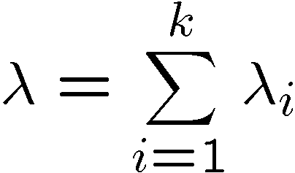









Merging of k Poisson streams with mean rate λ_{i} results in a Poisson stream with mean rate λ given by
Splitting of a Poisson stream into k substreams such that the probability of a job going to the i^{th} substream is P_{i}, each substream is also Poisson with a mean rate of P_{i}λ
+

Slide 26
If the arrivals to a single server with exponential service time are Poisson with mean rate λ, the departures are also Poisson with the same rate λ, provided that λ< µ
Arrival rate λ
Service rate μ
If the arrivals to a service facility with m service centers are Poisson with a mean rate λ, the departures also constitute a Poisson stream with same rate λ, provided λ< Ʃ µ_{i}

Slide 27
PASTA property
PASTA: Poisson Arrivals See Time Averages
It refers to the expected state of a queuing system as seen by an arrival from a Poisson process
Meaning: When a customer arrives, it finds the same situation in the queueing system as an outside observer looking at the system at an arbitrary point in time.
If an external observer samples a system at a random instant:
P(system state = x) = P (state as seen by a Poisson arrival is x)
Therefore, the expected value of any parameter of the queue at the instant of a Poisson arrival is simply the long-run average value of that parameter

Slide 28
Types of Stochastic Processes
Markov
Processes
Birth-death
Processes
Poisson
Processes

Slide 29
Model Queuing System
λ
μ
Queue
Server
Strategy:
Use Little’s law on both the complete system and its parts to reason about average time in the queue

Slide 30
Kendall Notation
Six parameters in shorthand
First three typically used, unless specified
Arrival Distribution
Probability of a new packet arrives in time t
Service Distribution
Probability distribution packet is serviced in time t
Number of servers
Total Capacity (infinite if not specified)
Population Size (infinite)
Service Discipline (FCFS/FIFO)

Slide 31
Distributions
M: Exponential
D: Deterministic (e.g. fixed constant)
E_{k}: Erlang with parameter k
H_{k}: Hyperexponential with param. k
G: General (anything)
M/M/1 is the simplest ‘realistic’ queue

Slide 32
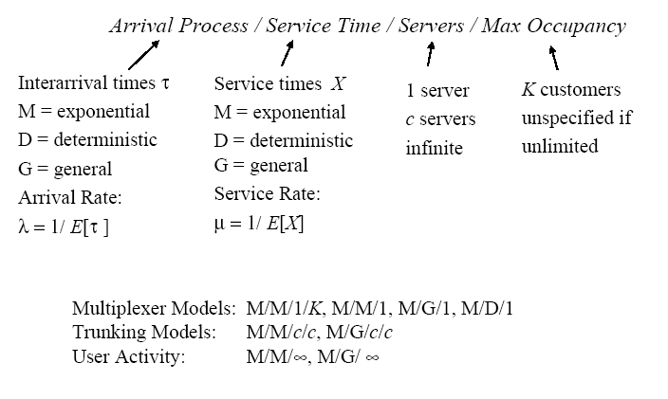
Queueing Model Classification

Slide 33
M/M/1 queue model
L
Lq
λ
λ
μ
Wq
W

Slide 34
The M/M/1 System
Poisson Process
Exponential server
output
queue

Slide 35
λ
μ
Queue
Server

